Slide 1

ABE 715
Computer Programming
Lecture 16: Course Review & Future Trends
From Code to Smart Farms: The Journey So Far
Dr. Kadeghe G. Fue
Department of Agricultural Engineering
1

Slide 2
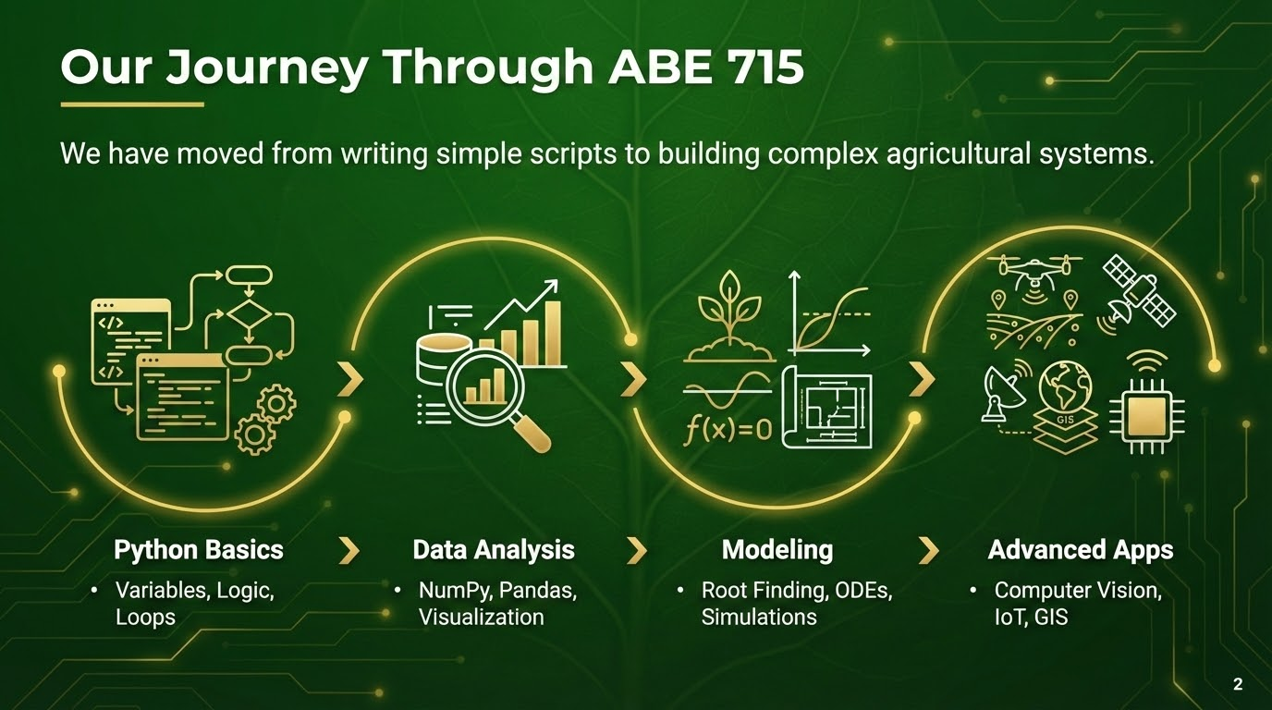

Slide 3
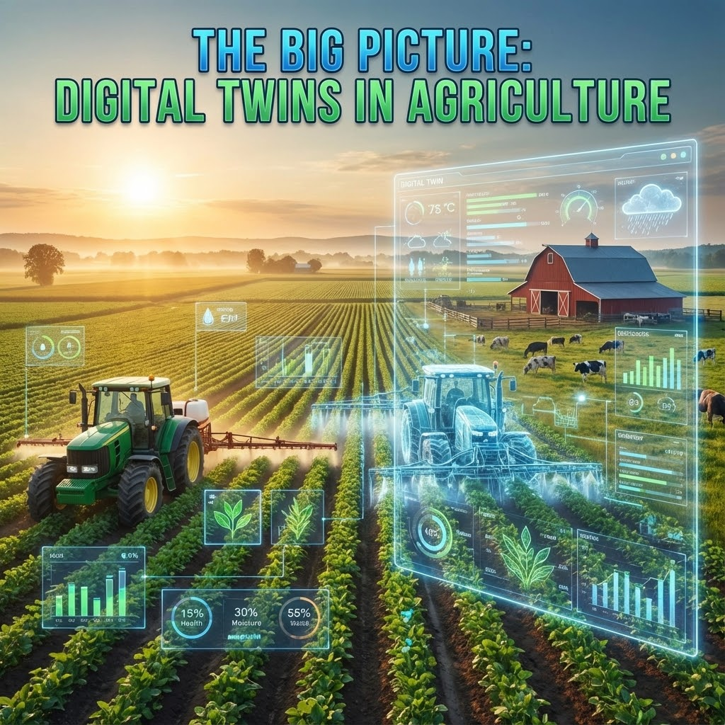

The Big Picture: Digital Twins
Connecting the Dots
All the skills you learned converge into the concept of a Digital Twin.
•
Sensors (IoT) feed real-time data.
•
Models (ODEs) simulate growth.
•
Vision (CV) monitors health.
•
Code (Python) ties it all together.
3

Slide 4
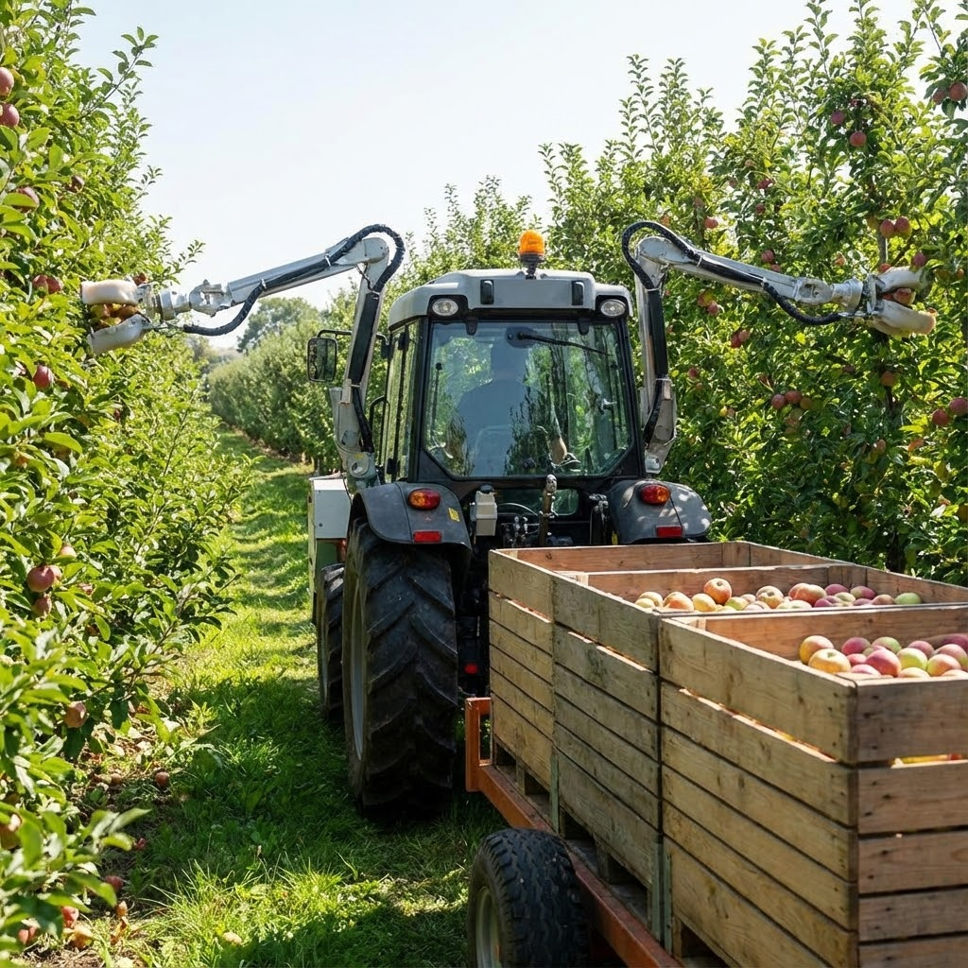

Trend 1: Autonomous Farming
Robotics & AI
The future is autonomous.
•
Laser Weeding: Using Computer Vision to zap weeds without chemicals.
•
Swarm Robotics: Many small robots instead of one giant tractor.
•
Fruit Picking: Soft robotic arms handling delicate crops.
4

Slide 5
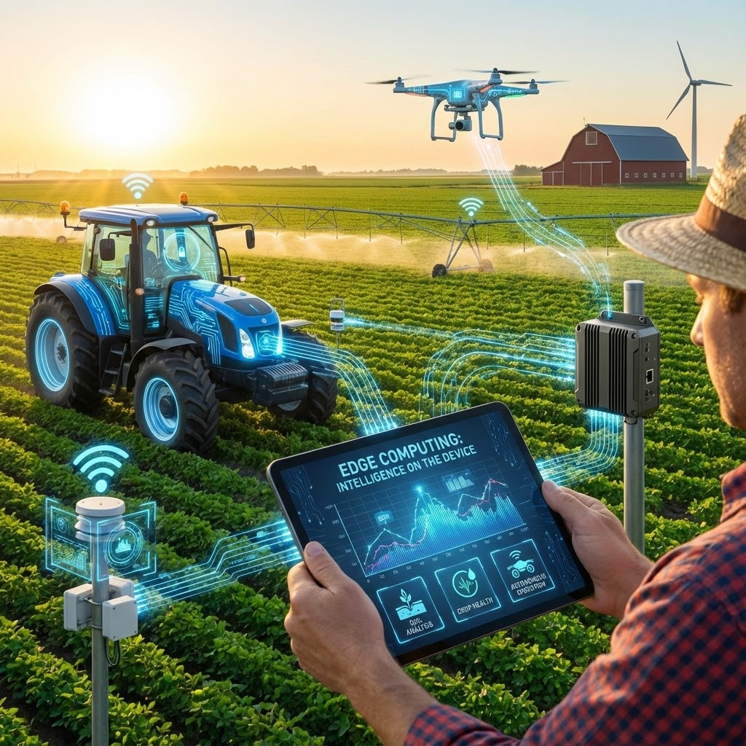
Trend 2: Edge Computing
Intelligence on the Device
Sending video to the cloud is slow and expensive. Edge AI processes data on the tractor or drone.
•
TinyML: Running Machine Learning on ESP32 microcontrollers.
•
Real-time Decision: Spray nozzle opens in milliseconds upon detecting a weed.
5

Slide 6
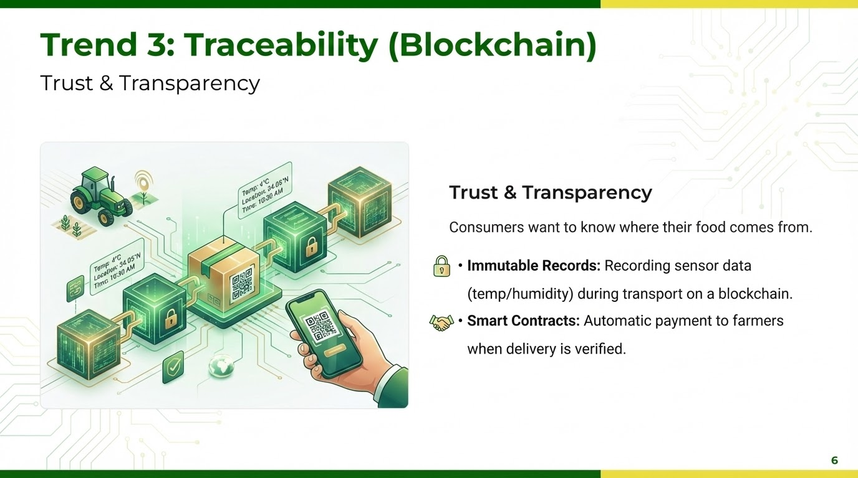

Slide 7





Where do you go from here?
AgTech Developer
Data Scientist
Building software for farm management systems (FMS) and mobile apps for farmers.
Analyzing yield maps, satellite imagery, and weather data to optimize inputs.
Hardware Engineer
Research
Designing IoT sensors, drone payloads, and automation controllers.
Developing new models for climate resilience and crop genetics.
7

Slide 8
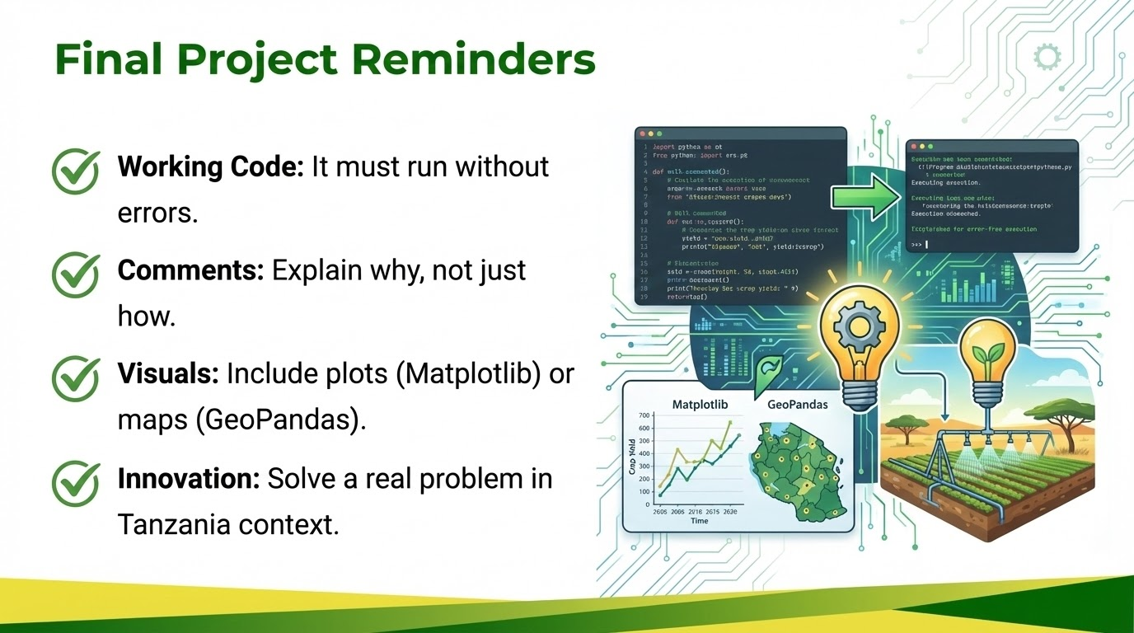

Slide 9

Final Reflection
The Innovation Pitch
Scenario: You are pitching a new AgTech startup to investors based on one concept from this course.
Task: Write a 1-page concept note (or pseudo-code architecture) describing:
1.
The Problem: (e.g., Post-harvest loss, Water scarcity).
2.
The Solution: How you combine Hardware (IoT) + Software (Python) to solve it.
3.
The Value: How does it save money or increase yield?
9

Slide 10



Thank You!
Keep Coding, Keep Innovating.
Dr. Kadeghe G. Fue
kadefue@sua.ac.tz
10

